Slide 1
TAFJ Training

Slide 2
T24 is available on two platforms C and Java
TAFC –Temenos application framework in C.
TAFJ –Temenos application framework in Java.
TAFJ is our proprietary runtime and compiler for jBC code, written in 100% java. It allows compiling and running jBC programs on Java.
TAFJ manages the connectivity on JDBC compliant databases like Oracle, Microsoft SQL Server, DB2, and for development purposes on H2.
T24 on TAFJ R15 runs on JDK 1.6 and above

Slide 3
T24 source code(*.b) can be compiled into java classes(*.class) on TAFJ. The TAFJ lexer-parser-tree walker translates standard jBCcode into equivalent Java code and generates the source code file(.java), which is then compiled into a java compliant bytecode(.class) using the standard javaccompiler.
The .java files are deleted after compilation.
The bytecode can be run on any JVM thus making T24 platform independent.
TAFJ uses log4J loggers and maintains extensive logs.
TAFJ uses only free and open source software's for all 3rdparty requirements, like H2, jBoss, JDK, eclipse etc.

Slide 4
TAFJ Commands
tRun
tCompile
tShow
tDiag
DBTools
JED
TAFJ Command to start TSM and AGENT

Slide 5
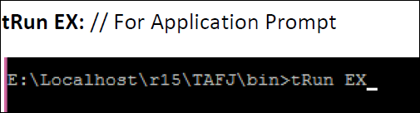
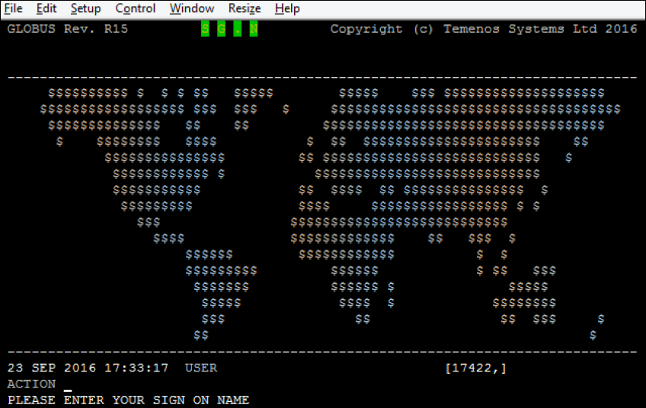
tRun
tRun is the main entry point for running a program. This is a script in the /bin directory. It is used to execute the Compiled Basic Files

Slide 6
tCompile
tCompile is the main entry point for compiling a program. This is a script in the /bin directory. It is used to execute the Compiled Basic Files.
The compilation of a basic program is done using tCompile (in the <TAFJ_HOME>/bin directory). As there is not a VOC as such, you must give the full path to the program you want to compile, unless the SOURCE is in the BASIC path specified in the TAFJ configuration file (tafj.property).
Syntax 1: tCompile <Program Path> <Program Name> // It will compile only one program.

Slide 7
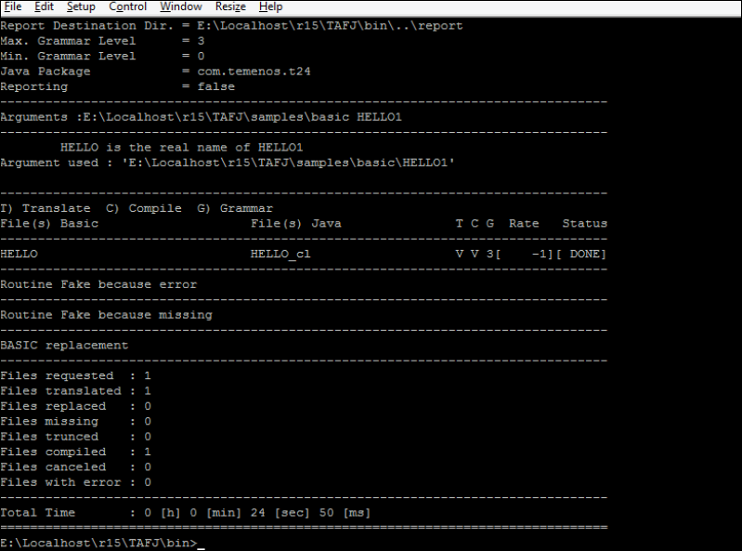
tCompile

Slide 8
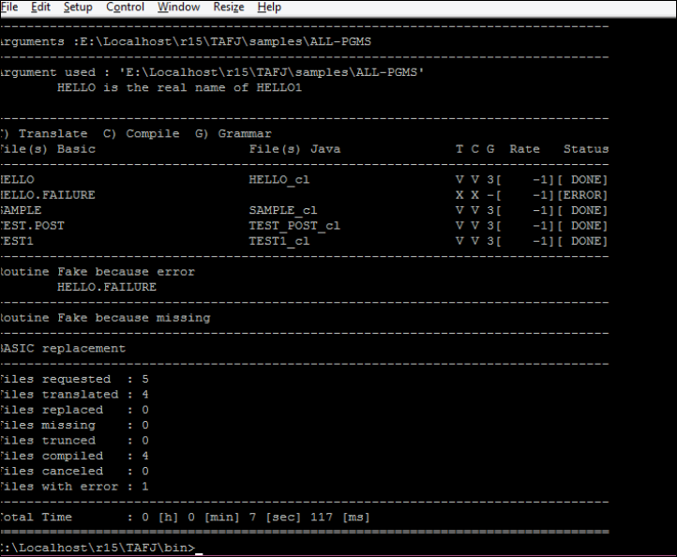
tCompile
Syntax 2: tCompile <Program Path> // It will compile all the programs from the given directory.

Slide 9
tCompile
Example:
tCompile HELLO.b
Look for HELLO.b in the current directory, and if not found, uses the “temn.tafj.directory.basic”
tCompile /home/user/MSK.BP/HELLO.b
Look for /home/user/MSK.BP/HELLO and compile it.
tCompile /home/user/MSK.BP
Compile the contents of the whole directory MSK.BP.
tCompile /home/user/MSK.BP/H*
Compile only the file starting with “H”
tCompile ../MSK.BP
Compile the entire relative directory.

Slide 10
tCompile
tCompile -reject */EB.* /home/user/MSK.BP
Compile the content of the whole directory MSK.BP but not the files starting with EB.
tCompile -reject */SUB/* /home/user/MSK.BP
Compile the content of the whole directory MSK.BP but not the subfolders called SUB.
tCompile -reject */SUB/EB.* /home/user/MSK.BP
Compile the contents of the whole directory MSK.BP but not the files starting with EB contained in subfolder SUB.
tCompile -reject “*/SUB/*|*/SUB2/*” /home/user/MSK.BP
Compile the contents of the whole directory MSK.BP but exclude subfolder SUB and SUB2.

Slide 11
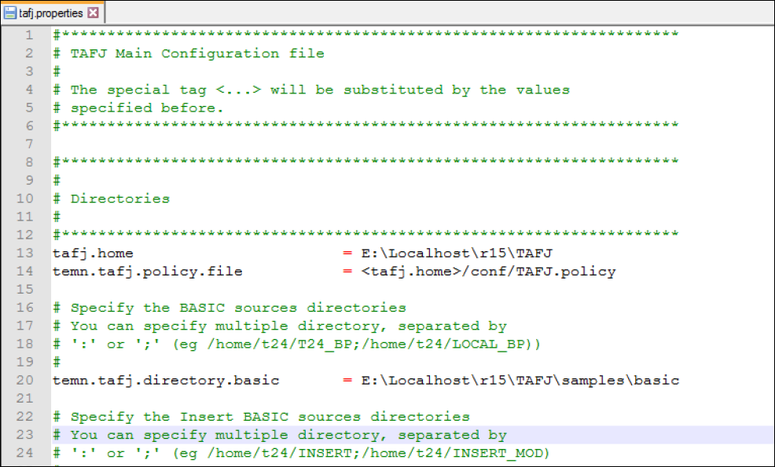
tCompile
The default path for the routine is mentioned in tafj.properites file. This file is under TAFJ_HOME\conf

Slide 12

Program Execution
Syntax: tRun <Program Name> //To execute the program
Output:

Slide 13
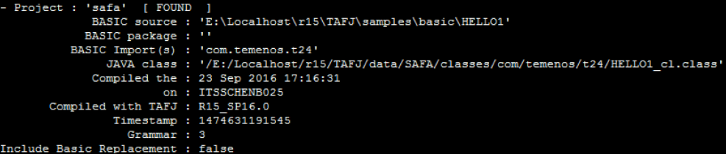
tShow
tShow is part of the TAFJ tools. It allows finding easily where your BASIC source has been compiled, when and on what machine it has been compiled. It can also produce a report of all the dupicate classes when run with –d argument.
Syntax: tShow <Program Name>
Output:

Slide 14

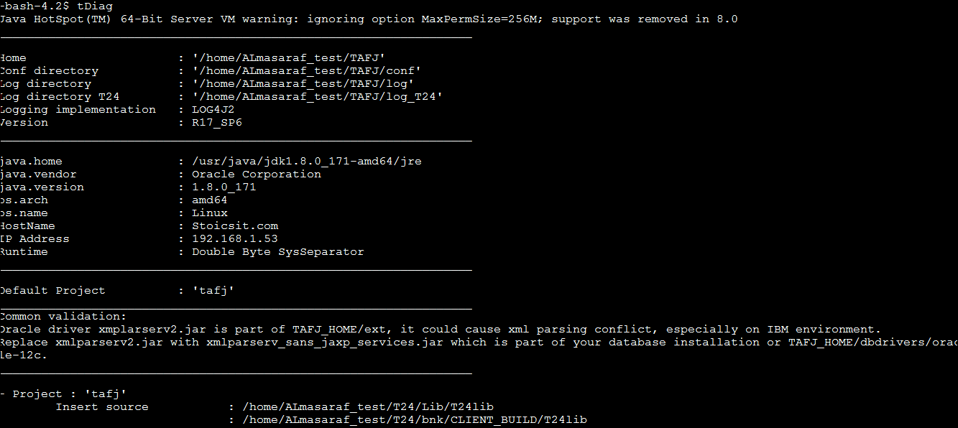
tDiag
tDiag is part of the TAFJ tools. Displays Information about TAFJ environment.
It is just like jDiag.
Syntax: tDiag <Option>
Output:

Slide 15
DBTools
TAFJ-DBTools will be accessed only with authenticated users. Hence username and password has to be passed as parameters to DBTools.
The users to access DBTools needs to be created using a bat file tAddUser. If there are 3 unsuccessful attempts, user gets blocked. The blocked user cannot be used further.
TAFJ-DBTools Console provides access to SQL / JQL / OFS statements.

Slide 16
DBTools
Functionalities:
Execute SQL statements
Execute JQL statements
Execute OFS statements
Execute JED application (edit and modify record)
Extract data from database to file
Load data from file to database
Show current locks on database
Release locks on database
Display statistics on table

Slide 17
DBTools
TAFJ-DBTools will be accessed only with authenticated users. The users to access DBTools needs to be created using a bat file tAddUser.
Creating DBTools user:
tAddUser -u <username > –p <password>
Eg: tAddUser -u t24user -p Temenos_123
DBTools Login :
DBTools -u <username > –p <password>
Eg : DBTools -u t24user -p Temenos_123

Slide 18
DBTools Presentation
DBTools console consists of three panels:
Header panel that contains information about the current mode or running command
Main panel that contains the result of the last executed command
Footer panel that contains the command line

Slide 19
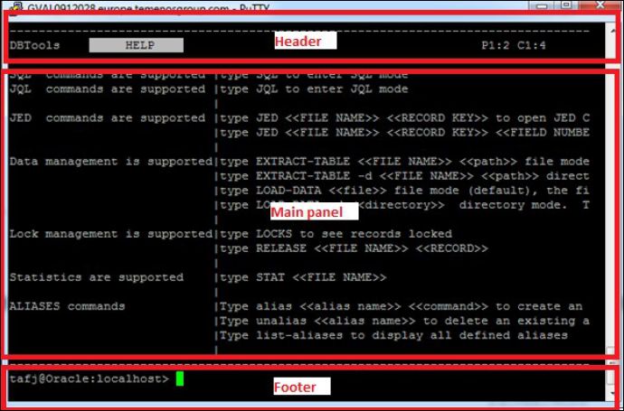
DBTools Presentation

Slide 20
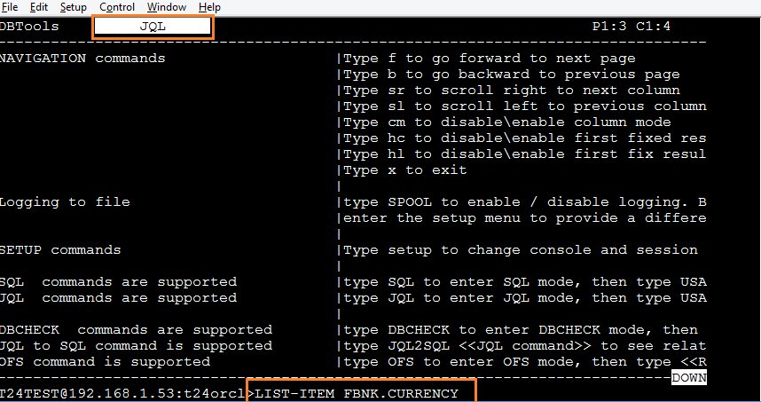
To script a JQL command

Slide 21
JQL statements
To execute JQL statements, first you have to enter JQL mode by typing command “JQL” on the command line or by prefixing your JQL command with JQL keyword.
COPY <<Source Table Name>> <<Destination TableName>> <<RecId optional>>
COUNT <<VOC File name>>
GETDBNAME <<VOC File name>>
LIST-ITEM <<VOC File name>> <<WITH clause>>
CLEAR-FILE <<VOC File name>>
CREATE-FILE <<VOC File name>>
DELETE-FILE <<VOC File name>>
LOCKS
RELEASE <<Session ID>>

Slide 22
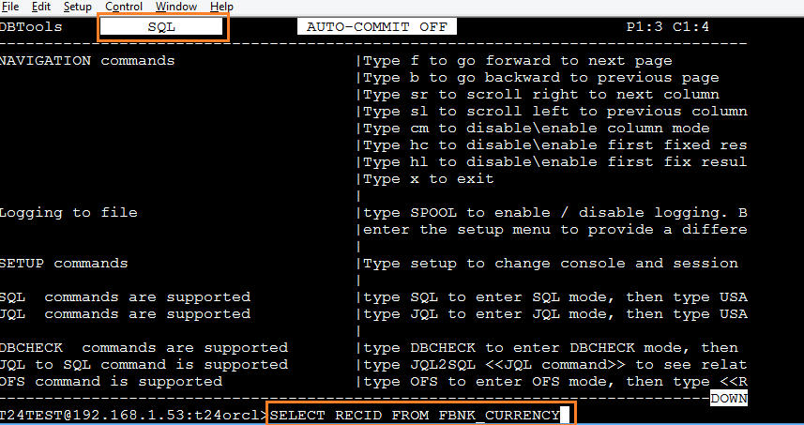
To script a SQL command

Slide 23
SQL statements
To execute SQL statements, first you have to enter SQL mode by typing command “SQL” on the command line or by prefixing your SQL command with SQL keyword.
SELECT
INSERT
UPDATE
DELETE
CREATE
ALTER
DROP
COMMIT
ROLLBACK

Slide 24
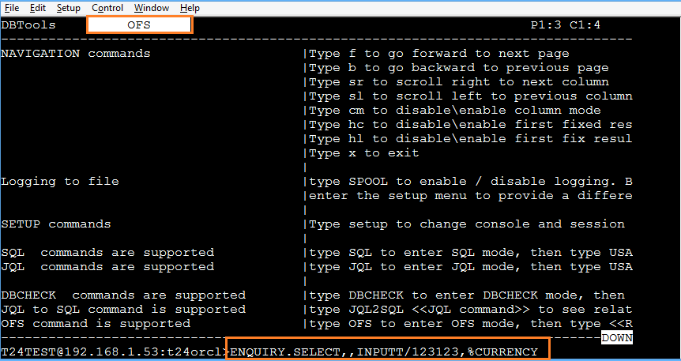
To script a OFS command

Slide 25
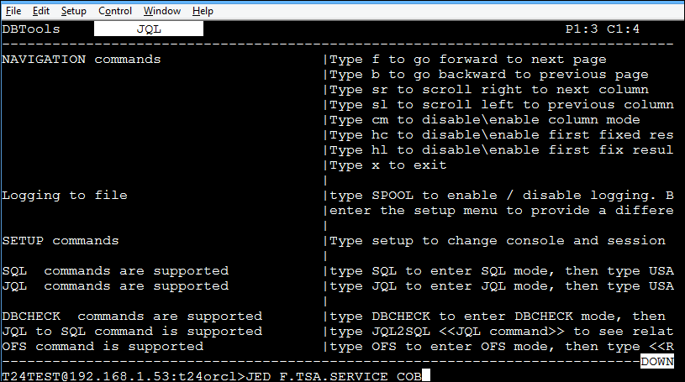
JED
You can call JED console to display and edit database records by using command JED <<FILE NAME>> <<RECORD KEY>>

Slide 26
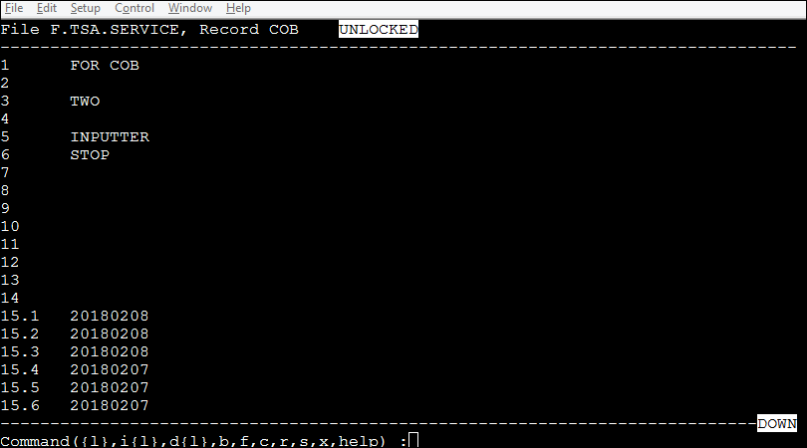
JED

Slide 27
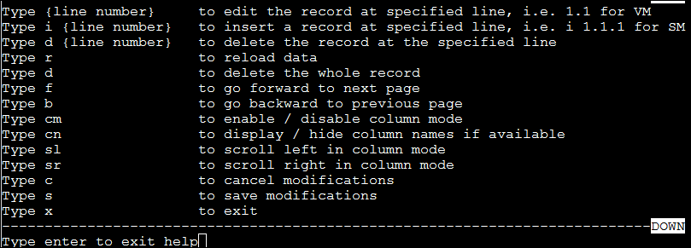
JED

Slide 28
TAFJ Command to start TSM and AGENT
TAFJ allows to execute TSM in front-end(Browser) as well as back-end.
Below are Commands to start TSM in back-end in Debug mode.
tRun START.TSM –DEBUG
tRun tSA <Agent_number>

Slide 29
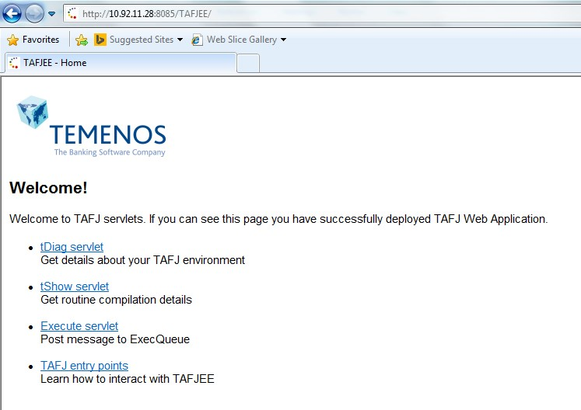
TAFJEE
URL Syntax: <<host>> :<< port>>/TAFJEE/

Slide 30
TAFJEE
http://localhost:9089/TAFJEE/tShow

Slide 31
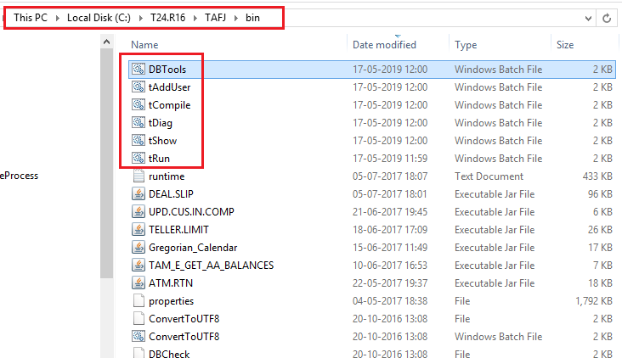
Directory Structure in TAFJ

Slide 32
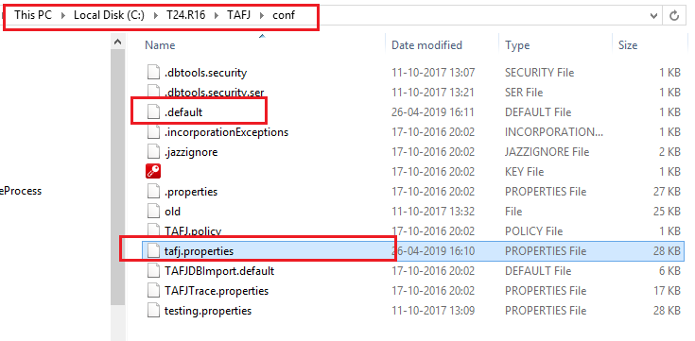
Directory Structure in TAFJ

Slide 33
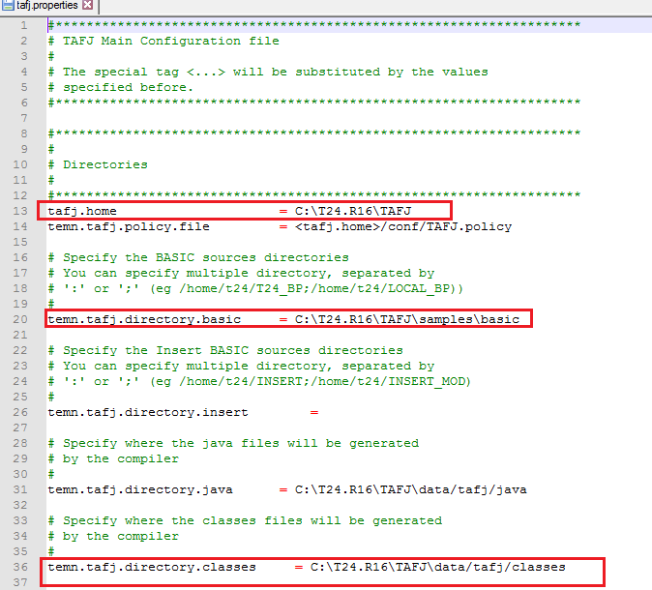
tafj.properties

Slide 34
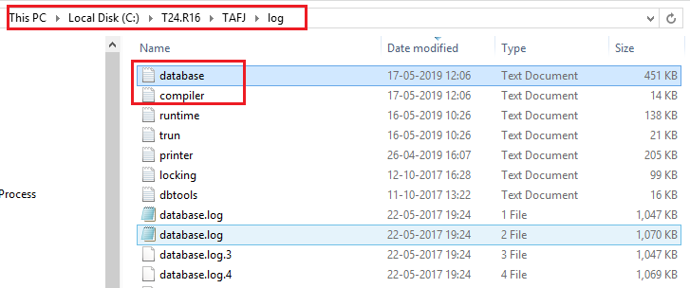
Directory Structure in TAFJ

Slide 35
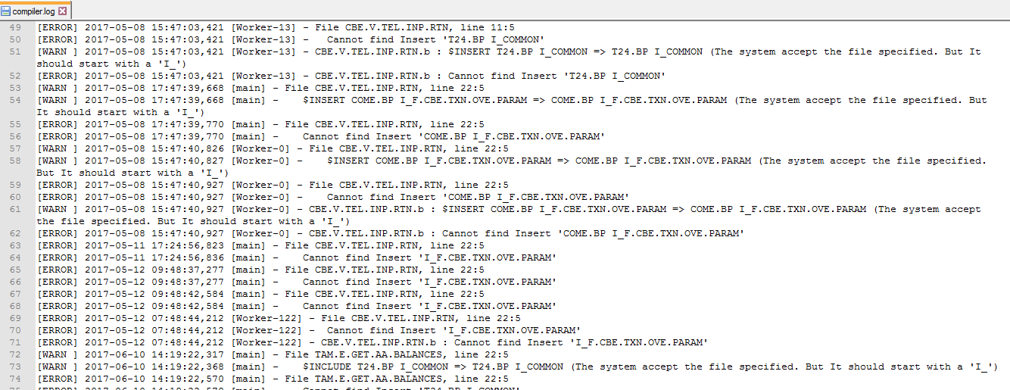
Logs

Slide 36
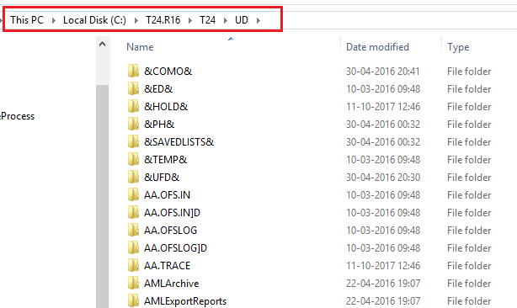
Directory Structure in TAFJ

Slide 37
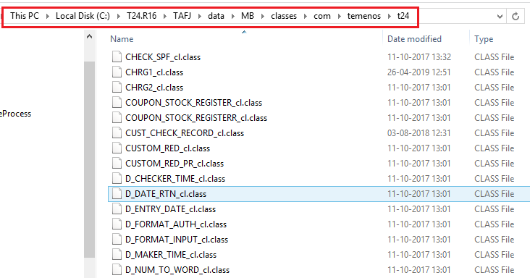
Directory Structure in TAFJ

Slide 38
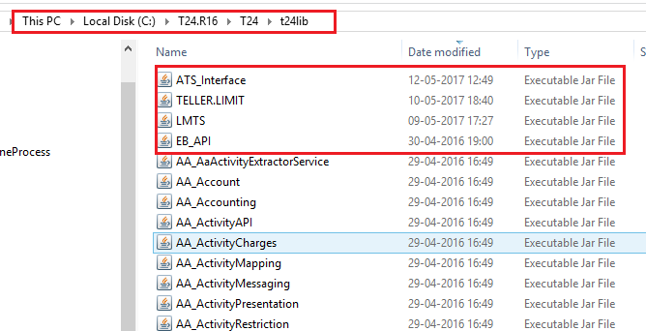
Directory Structure in TAFJ

Slide 39
To create jar in TAFJ
jar –cvf <jarname>.jar *

Slide 40
Thank You

